Slide 1
DeepCSAT – Ecommerce Customer Satisfaction Score Prediction

Slide 2
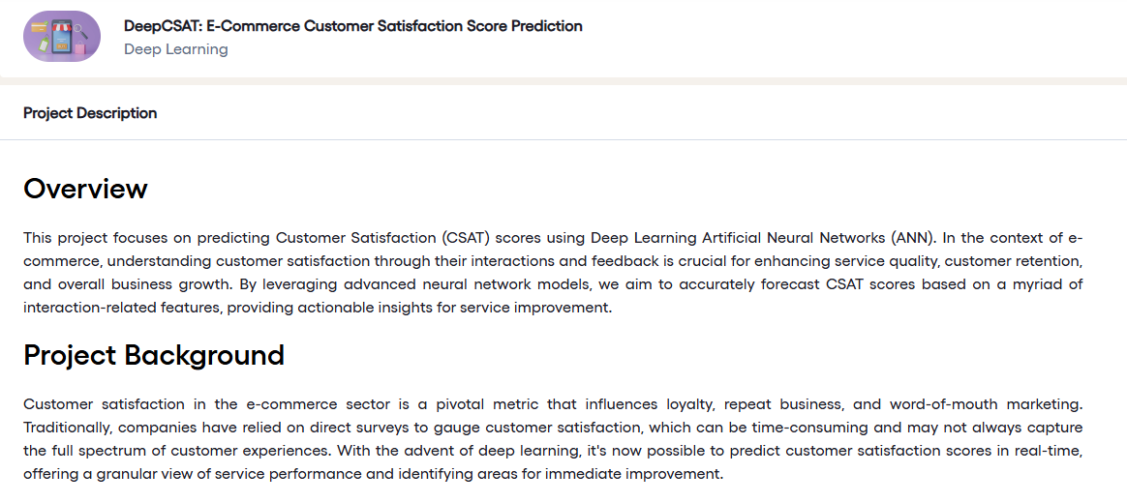

Slide 3
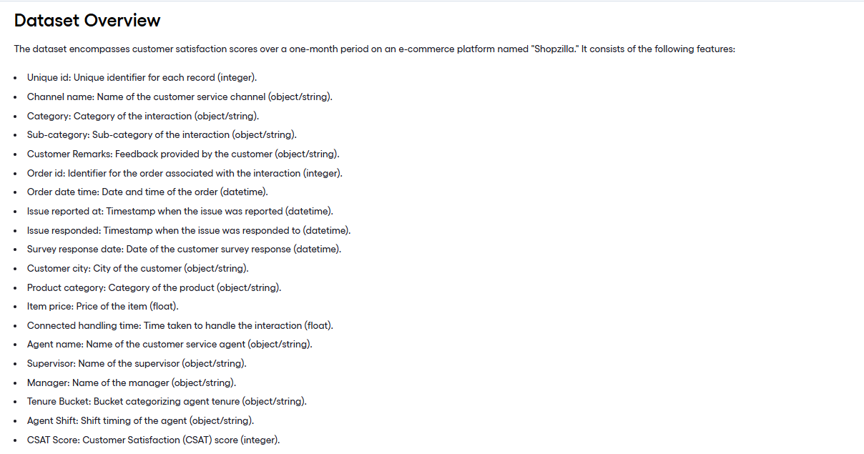

Slide 4
